Slide 1

House Price Prediction
Ankit Nigam
GCDAI – August Batch 2019

Slide 2

Dataset Information https://github.com/insaid2018/Term-2/blob/master/Projects/houseprices.txt

Slide 3
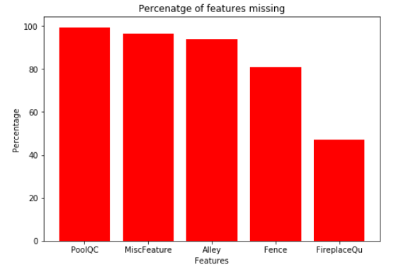
Handling missing values in dataset

Slide 4
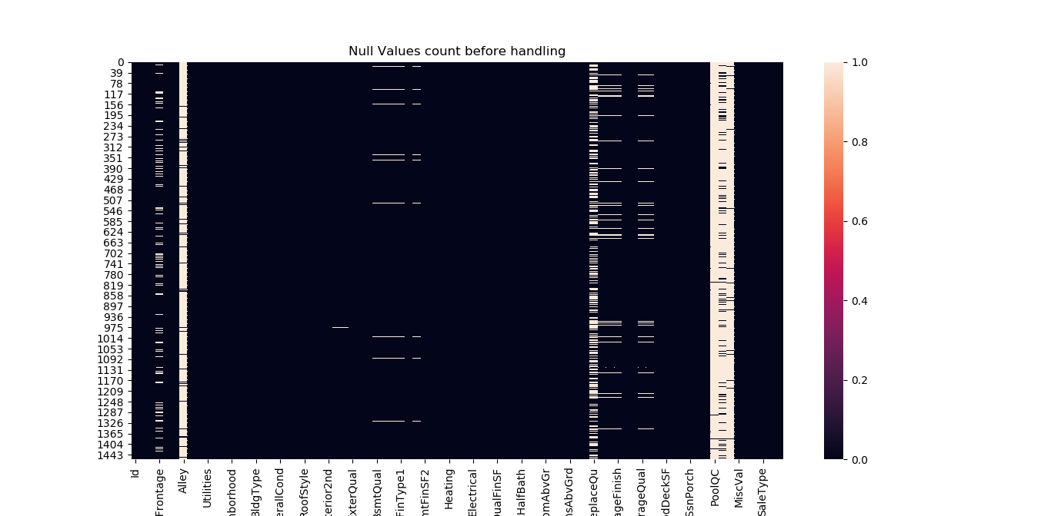
Handling missing values in dataset

Slide 5
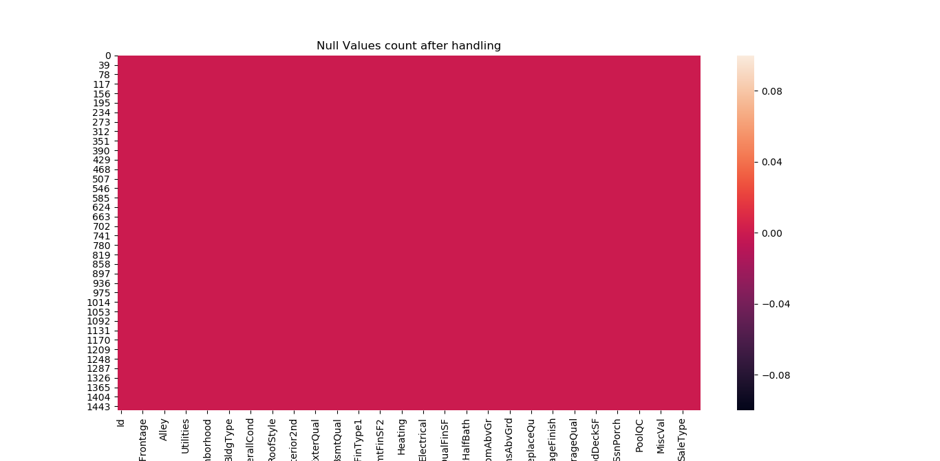
Handling missing values in dataset

Slide 6
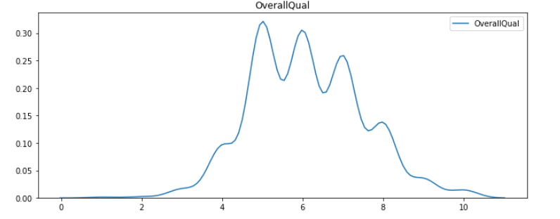
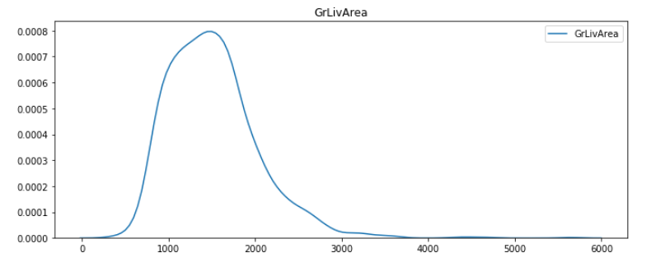
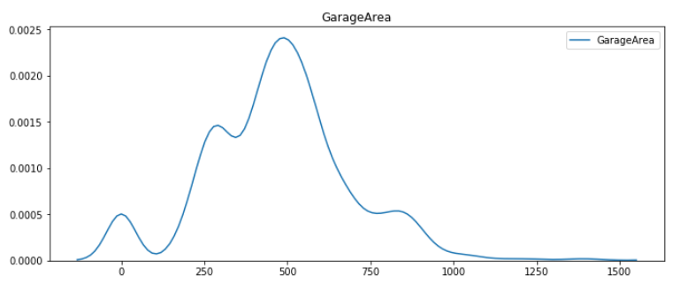
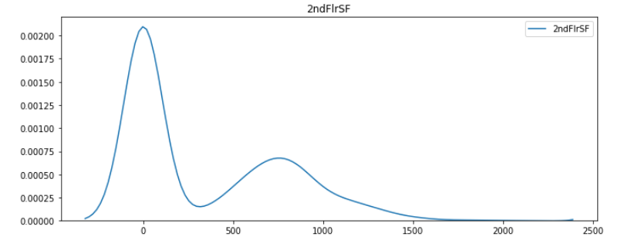
Distribution of input features

Slide 7
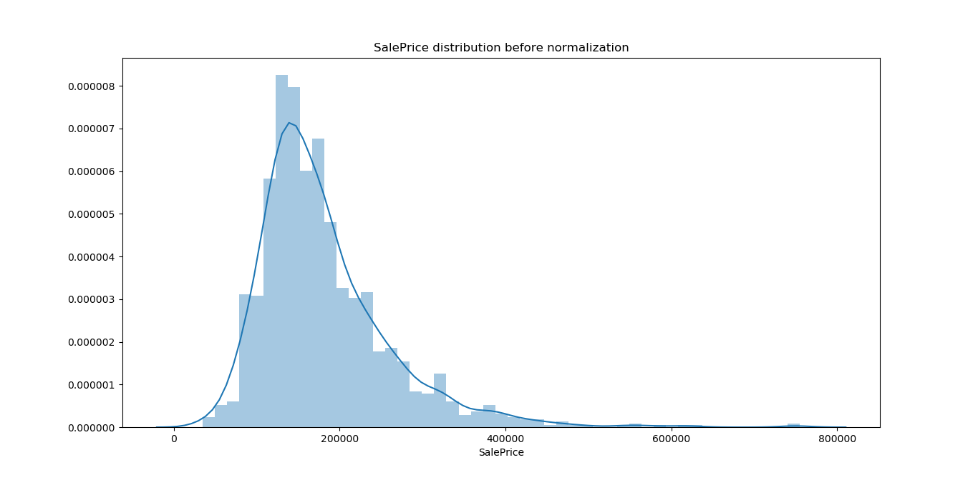
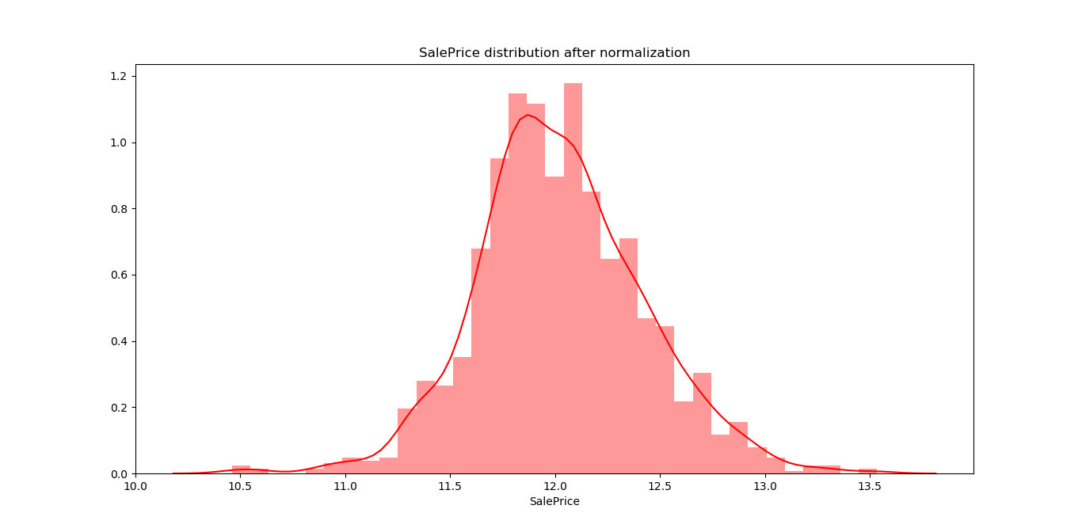
Distribution of target data

Slide 8
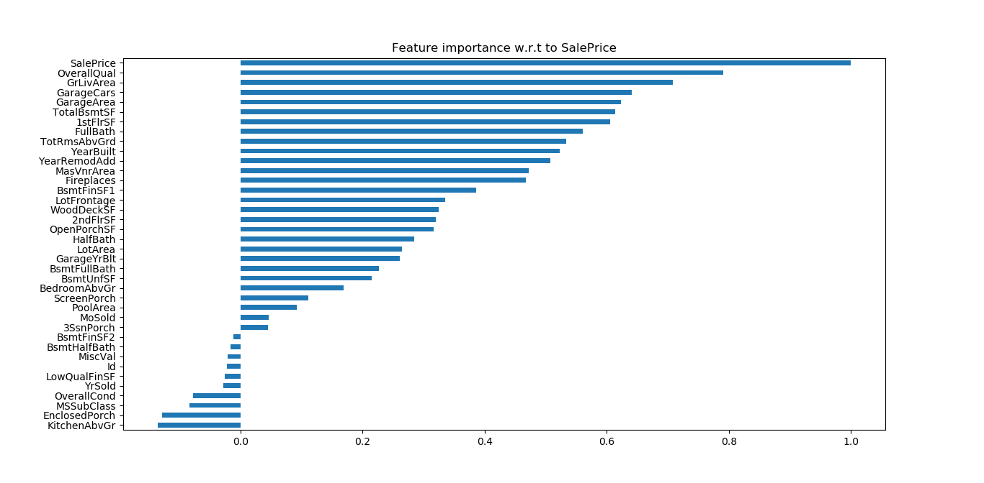
Selecting continuous features for prediction

Slide 9
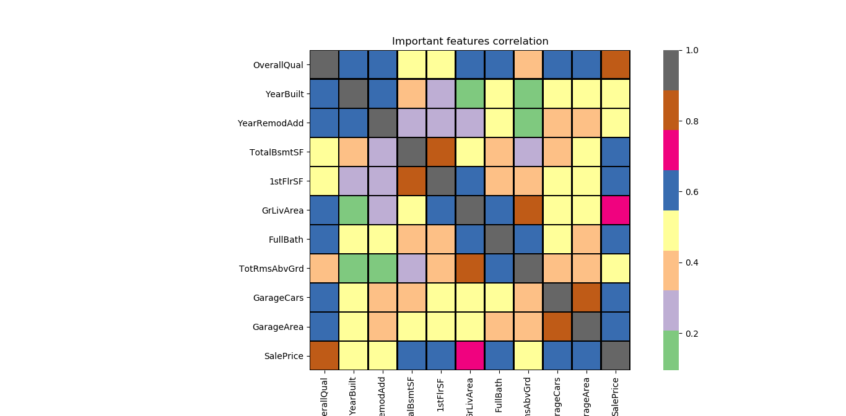
Selecting continuous features for prediction

Slide 10
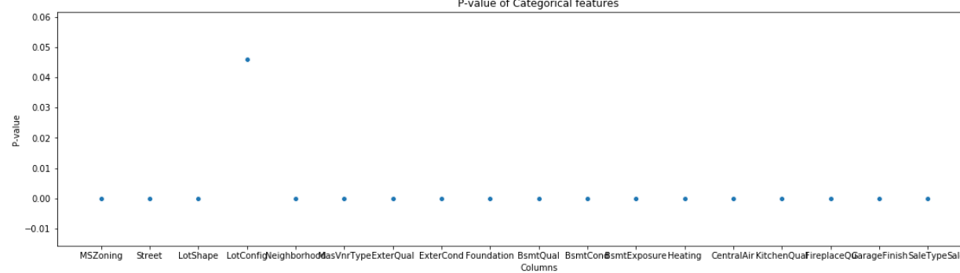
Selecting categorical features for prediction

Slide 11
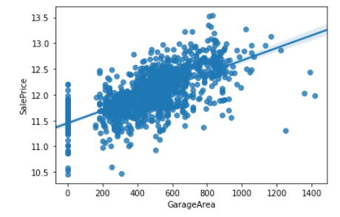
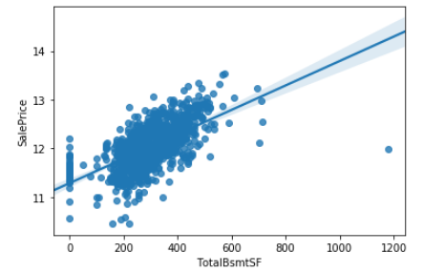
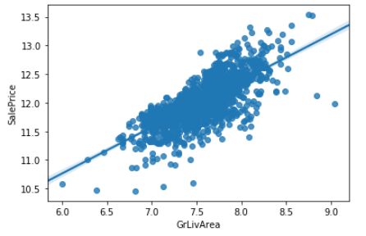
Assumptions for Linear Regression
There has to be linear relationship between input features and target variable

Slide 12
Assumptions for Linear Regression
Target variable should be normally distributed

Slide 13
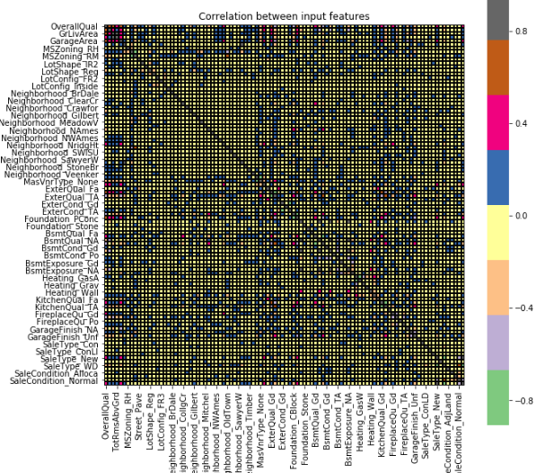
Assumptions for Linear Regression
Independent features are not correlated - No multicollinearity

Slide 14
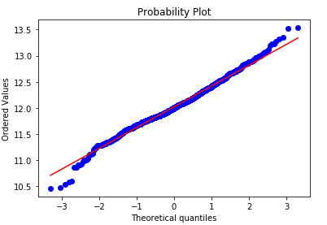
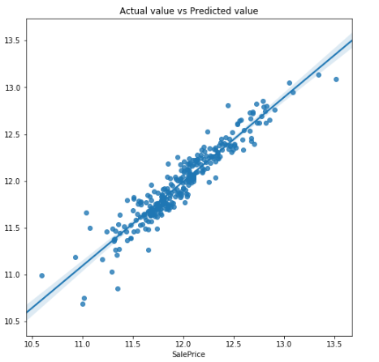
Assumptions for Linear Regression
The error term must have constant variance – Homoscedasticity

Slide 15



Comapring Models for Prediction
Linear Regression
Random Forest
Decision Tree

Slide 16
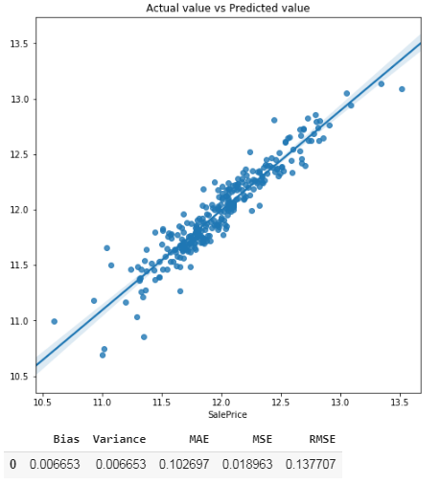
Conclusion
Since errors along with Bias and Variance is low in Linear regression, so we will prefer Linear regression model

Slide 17
THANK YOU

